Slide 1
Introduction to GTK+ Programming
Guddu Kumar Mishra
Batch-65

Slide 2
Table of Contents
Brief History of GTK
An Introduction to GTK
Features of GTK ?
Basic Libraries of GTK
How to write a GTK Program
How to compile a GTK Program
A Basic GTK+ Program
GTK's Signal Handling model
Application
Conclusion
Reference
www.globaledgesoft.com

Slide 3
Brief History of GTK+
- Peter Mattis, Splencer Kimball, Josh McDonald first built the Tool Kit called 'motif'.
But it failed to give the flexibility they desired, they went re-built it and named it ‘GIMP Tool Kit' (GTK).
- GTK+ was created for the development of a raster- graphics editor called GIMP (GNU Image Manipulation Program).
- GTK came into existence in 1997 in the eXperimental Computing Facility at the University of California, Berkeley.
- GTK+ is an enhanced version of GTK.
www.globaledgesoft.com

Slide 4
An Introduction to GTK
- GTK is essentially an object oriented application programmers interface (API). Although written completely in C, it is implemented using the idea of classes and callback functions (pointers to functions) .
- GTK+ is a collection of graphical objects and corresponding function calls needed to implement them.
- The graphical objects are called widgets. The addition of corresponding function calls creates a toolkit.
www.globaledgesoft.com

Slide 5
Contd..
- Widgets have associated methods, which perform actions on the object.
- Application programmer supplied methods are known as handlers in GTK+.
- GTK+ widget set now has more than 60 widgets.
www.globaledgesoft.com

Slide 6
Contd..
- GTK+ is a cross-platform API.
- Hence for it to perform on other language, one needs to install a binding between the OS and the Associated Library named as Language Bindings.
- Note: As GTK+ is written on C, no Language Binding is required for it to be integrated on C.
www.globaledgesoft.com

Slide 7
Features of GTK+ ?
→ It masks the need to interact with the underlying rendering system. The code looks the same for all operating systems.
→ All low level calls to the system, are hidden and managed by the library functions.
→ Licensed Under the LGPL (Lesser General Public License).
→ Freely available to everyone.
→ One is free to distribute the GTK+ Source, develop their own applications.
→ Any problems encountered, can be fixed by the user himself instead of the technical support being called and fixing it.
www.globaledgesoft.com

Slide 8
GTK+ Language Binding
→ GTK+ Language Binding is needed for the for few language are listed below:
Gtkmm : binding for C++.
PyGtk : binding for Python.
Gtk2-perl : for Perl.
PHP-GTK : for PHP.
Java-Gnome : for java.
www.globaledgesoft.com

Slide 9
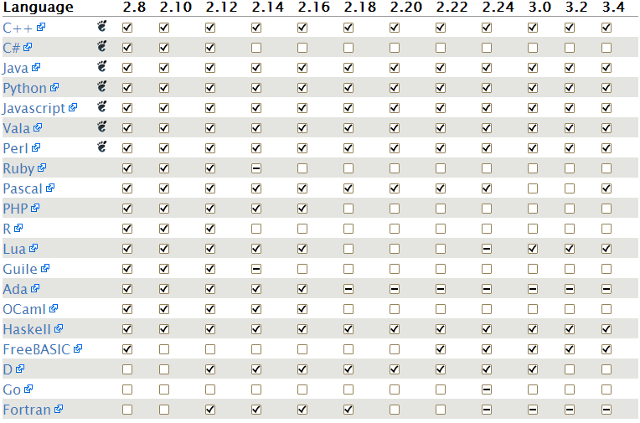
Contd…
www.globaledgesoft.com

Slide 10
Basic Libraries of GTK+
- Glib :general-purpose utility library, which provides us basic data types to be used in GTK+ Programming.
- Gobject : Implements the object-oriented Gtype system provide features of C++ like inheritance,polymorphism etc.
- GdkPixbuf : Provides client-side image manipulation functions which operate at 8-bit(1 character) level.
- Pango : Used for font rendering. It supports a vast variety of languages making it a standout from the crowd. Uses fontconfig and Free Type Libraries.
- ATK : Provides all GTK+ widgets with a built in method of handling accessibility.
www.globaledgesoft.com

Slide 11
Steps to write a GTK+ Program
Basic Requirements to write a simple GTK program:
->Header File
->main function.
->GTK widgets
->A function to initialize GTK and its libraries
->Displaying widgets
->gtk main loop.
www.globaledgesoft.com

Slide 12
contd..
- Header file is → <gtk/gtk.h>
- Initializing the GTK+ Environment → void gtk_init(int *argc_addr, char ***argv_addr)
- GtkWidgets :
GtkWidgets *gtk_window_new(GtkWindowType type)
Parameter types:
→ GTK_WINDOW_TOPLEVEL
→ GTK_WINDOW_POPUP
www.globaledgesoft.com

Slide 13
Contd..
void gtk_window_set_title(GtkWindow *window,
const gchar *title)
→ Parameter:
The GtkWindow type *window is given a name named “title”.
Void gtk_window_show(GtkWidget *widget)
→ Parameter :
Widget – the widget name to Display.
Void gtk_main(void)
No Parameter passed and No Return values.
www.globaledgesoft.com

Slide 14
A Basic Example
/*This program will create a window of default size 200*200 px named Hello World */
#include <gtk/gtk.h> /*including all *widgets,variable,function *available in gtk header file*/
int main (int argc, char *argv[])
{
GtkWidget *window;
gtk_init (&argc, &argv); //initializing gtk env. variable
window = gtk_window_new (GTK_WINDOW_TOPLEVEL);
gtk_window_set_title (GTK_WINDOW (window), "Hello World");
gtk_widget_show (window);
gtk_main ();
return 0;
}
www.globaledgesoft.com

Slide 15
How to Compile a GTK+ Program
To compile the program:
$gcc -Wall <filename.c> -o <exec_name> `pkg-config --libs --cflags gtk+-2.0`
To execute the program:
$<exec_name>
www.globaledgesoft.com

Slide 16
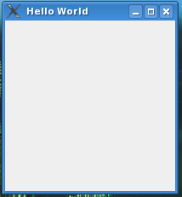
contd..
Output :
    By Default size Will be 200 x 200 px
www.globaledgesoft.com

Slide 17
Signals and Callbacks:
Gtk relies on signals and callback functions.
Signal are notifications that user has performed some specific tasks.
A function called when a signal is emitted is called as callback function.
It is a pointer to a function, which will call the function corresponding t
the signal emitted by the action performed.
www.globaledgesoft.com

Slide 18
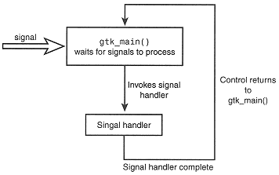
GTK+ Signal Handling Model
www.globaledgesoft.com

Slide 19
Contd..
guint g_signal_connect ( Gtkobject *object,
const gchar *name,
GCallback func,
gpointer func_data );
Parameter :
Object : widget name that that has to be monitored for the signal
Name : name of signal
Func : callback function name that will be called when signal will be emitted
Data : data passed to function
Callback function general form:
void callback_func( GtkWidget *widget, gpointer callback_data );
www.globaledgesoft.com

Slide 20
Types of Buttons Used
Different types of buttons:
1. Click able button:
gtk_button_new_with_label()
gtk_button_new_with_mnemonic()
2. Toggle button
gtk_toggle_button_new_with_label()
gtk_toggle_button_new_with_mnemonic()
3. check button
gtk_check_button_new_with_label()
gtk_check_button_new_with_mnemonic()
www.globaledgesoft.com

Slide 21
contd..
Radio button :
GtkWidget* gtk_radio_button_new_with_label (GSList *group,
const gchwar *label);
GtkWidget* gtk_radio_button_new_with_mnemonic
(GSList *group, const gchar *label);
gtk_radio_button_new_with_label_from_widget(GSList*group, const gchar *label) ;
www.globaledgesoft.com

Slide 22
contd..
One window can have only a single widget. To put multiple widgets, we have to put something called a container.
Types of boxes:
2.1. Vertical boxes :
  gtk_vbox_new()
2.2. Horizontal boxes :
  gtk_hbox_new()
www.globaledgesoft.com

Slide 23
Applications
# Chromium – Secure web browser employing Web Kit and developed in large part by Google
# AbiWord – Word processor
# Anjuta – Integrated development environment (IDE)
# Epiphany – Official GNOME web browser
www.globaledgesoft.com

Slide 24
Conclusion
GTK+ is a effective graphical tool kit to design powerful graphical user interface.
With the help of Language Bindings, it can be implemented in other languages like C++,Perl, Python .
Being an Open Source software ,can be used by anyone free of cost.
www.globaledgesoft.com

Slide 25
References :
Foundation of GTK+ Development – Andrew Krause
GTK+ Programming – by Martin, et al.
http://www.gtk.org
www.globaledgesoft.com

Slide 26
Thank You
www.globaledgesoft.com

